Slide 1

Oracle 12c: SQL
Chapter 8
Restricting Rows and Sorting Data
©2016. Cengage Learning. All rights reserved.

Slide 2
Objectives
Use a WHERE clause to restrict the rows returned by a query
Create a search condition using mathematical comparison operators
Use the BETWEEN…AND comparison operator to identify records within a range of values
Specify a list of values for a search condition using the IN comparison operator
©2016. Cengage Learning. All rights reserved.

Slide 3
Objectives (continued)
Search for patterns using the LIKE comparison operator
Identify the purpose of the % and _ wildcard characters
Join multiple search conditions using the appropriate logical operator
Perform searches for NULL values
Specify the order for the presentation of query results using an ORDER BY clause
©2016. Cengage Learning. All rights reserved.

Slide 4
RUN the JLDB_Build_8.sql script
Oracle 11g

Slide 5

WHERE Clause Syntax
A WHERE clause is used to retrieve rows based on a stated condition
Requires:
  Column name
  Comparison operator
  Value or column for comparison
Values are case sensitive
©2016. Cengage Learning. All rights reserved.

Slide 6
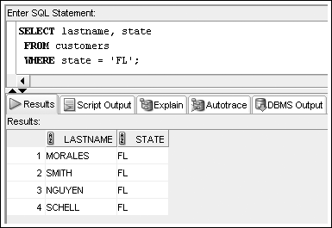
WHERE Clause Example
List WHERE clause after FROM clause
Enclose nonnumeric data in single quotes
©2016. Cengage Learning. All rights reserved.

Slide 7
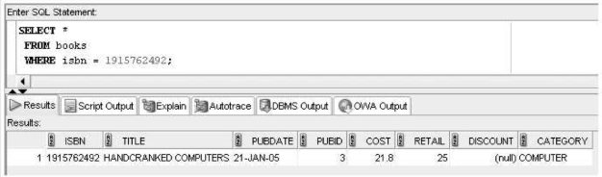
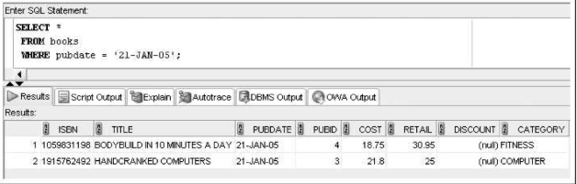
Sometimes you need to use a date as a search condition. Oracle 12c displays dates in the default format DD-MON-YY.
Oracle 11g

Slide 8
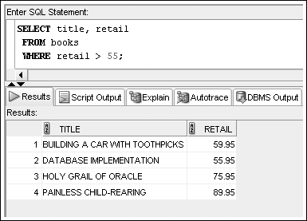
Comparison Operators
Indicate how the data should relate to the given search value
©2016. Cengage Learning. All rights reserved.

Slide 9
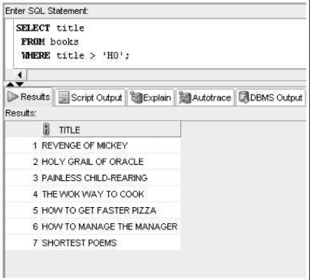
Comparison Operators
Indicate how the data should relate to the given search value
©2016. Cengage Learning. All rights reserved.

Slide 10
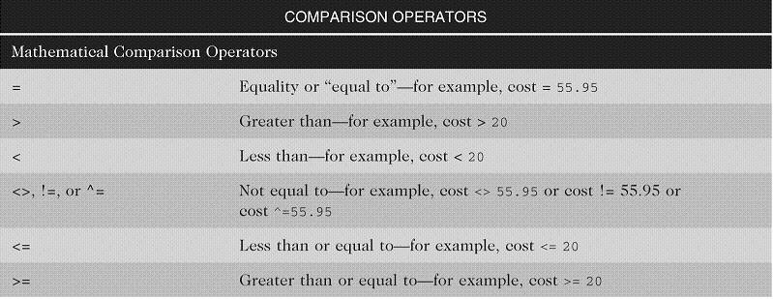
Arithmetic Comparison Operators
©2016. Cengage Learning. All rights reserved.

Slide 11
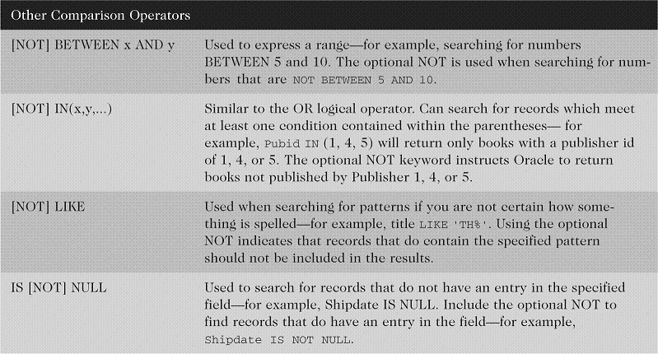
Other Comparison Operators
©2016. Cengage Learning. All rights reserved.

Slide 12
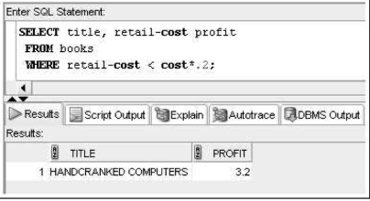
Oracle 11g

Slide 13
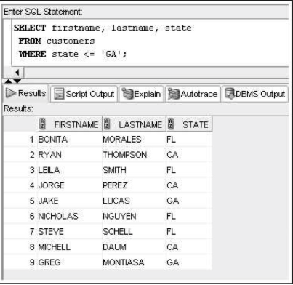
Oracle 11g

Slide 14
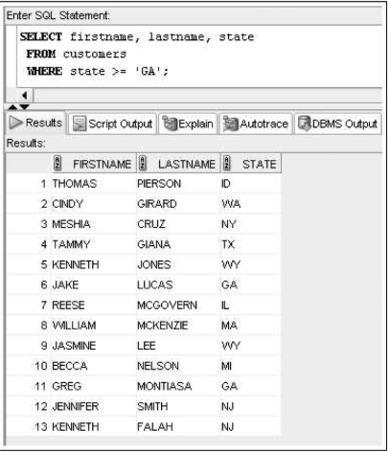
Oracle 11g

Slide 15
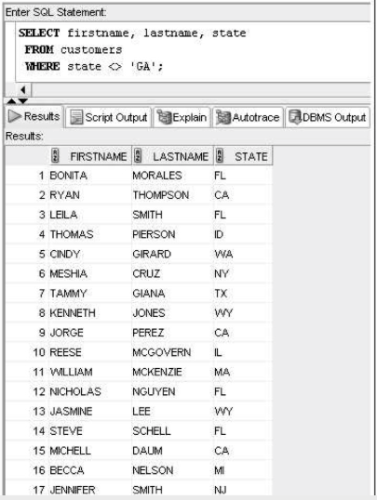
Oracle 11g

Slide 16
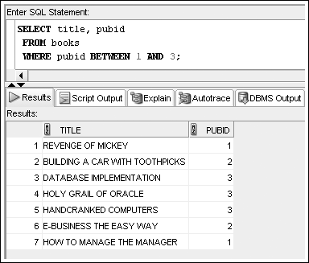
BETWEEN…AND Operator
Finds values in a specified range
©2016. Cengage Learning. All rights reserved.

Slide 17
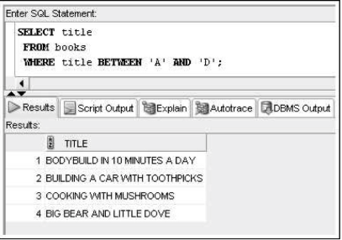
Search for book titles, from book table that start with a letter between A and D
Oracle 11g

Slide 18
IN Operator
Returns records that match a value in a specified list
List must be in parentheses
Values are separated by commas
©2016. Cengage Learning. All rights reserved.

Slide 19
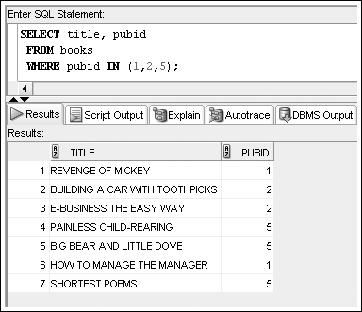
IN Operator Example
©2016. Cengage Learning. All rights reserved.

Slide 20
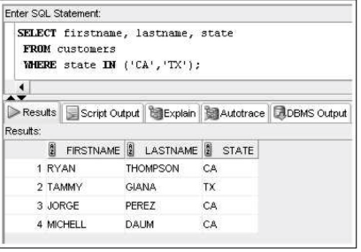
IN Operator Example
Search for Customer’s names, from customers table that live in California(CA) or Texas(TX)
©2016. Cengage Learning. All rights reserved.

Slide 21
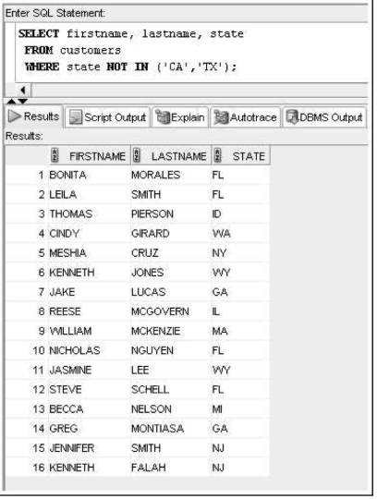
NOT Operator
Oracle 11g

Slide 22
LIKE Operator
Performs pattern searches
Used with wildcard characters
  Underscore (_) for exactly one character in the indicated position
  Percent sign (%) represents any number of characters
©2016. Cengage Learning. All rights reserved.

Slide 23
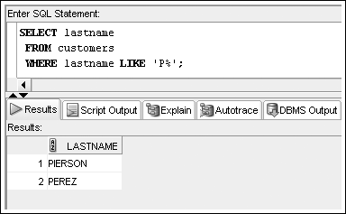
LIKE Operator Example
©2016. Cengage Learning. All rights reserved.

Slide 24
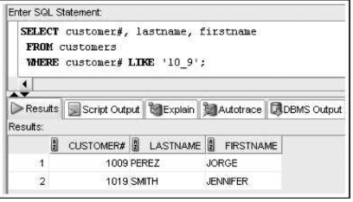
LIKE Operator Example
Search for Customer’s names, from customer table where Customer# starts with 10 and ends with a 9
©2016. Cengage Learning. All rights reserved.

Slide 25
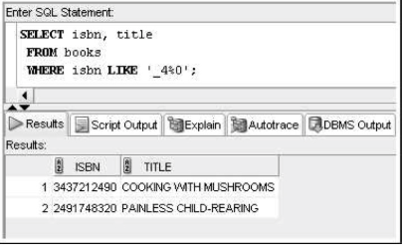
LIKE Operator Example
Search for book titles, from books table where ISBN starts with second digit is 4 and ends with a 0
©2016. Cengage Learning. All rights reserved.

Slide 26
Logical Operators
Used to combine conditions
Evaluated in order of NOT, AND, OR
  NOT – reverses meaning
  AND – both conditions must be TRUE
  OR – at least one condition must be TRUE
©2016. Cengage Learning. All rights reserved.

Slide 27
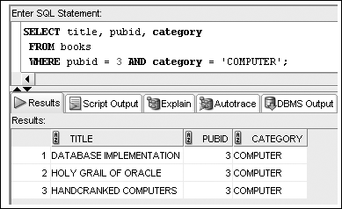
AND Logical Operator Example
©2016. Cengage Learning. All rights reserved.

Slide 28
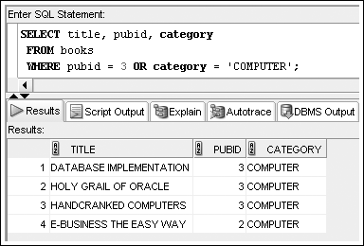
OR Logical Operator Example
Search for book titles, from books table that are either published by pubid 3 or are considered a “computer book” (in category).
©2016. Cengage Learning. All rights reserved.

Slide 29
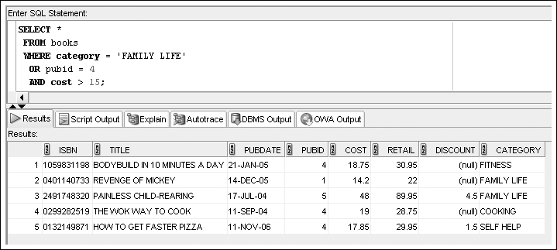
Multiple Logical Operators
Resolved in order of NOT, AND, OR
©2016. Cengage Learning. All rights reserved.

Slide 30
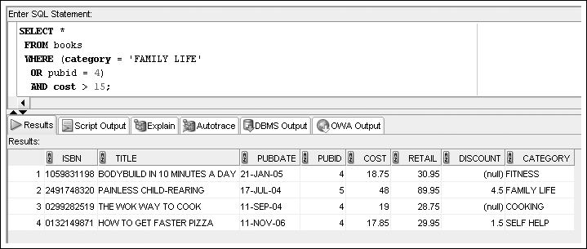
Multiple Logical Operators
Use parentheses to override the order of evaluation
©2016. Cengage Learning. All rights reserved.

Slide 31
Resolving Multiple Types of Operators
Arithmetic operators
Comparison operators
Logical operators
©2016. Cengage Learning. All rights reserved.

Slide 32
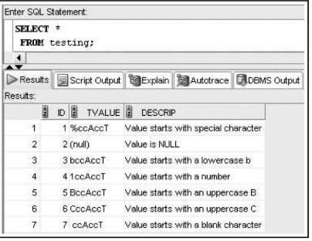
Check it out. . . .
Oracle 11g

Slide 33
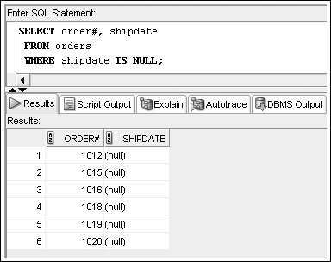
Treatment of NULL Values
Absence of data
Requires use of IS NULL operator
©2016. Cengage Learning. All rights reserved.

Slide 34
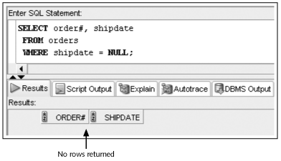
Treatment of NULL Values (continued)
A common error is using = NULL, which does not raise an Oracle error but also does not return any rows
©2016. Cengage Learning. All rights reserved.

Slide 35
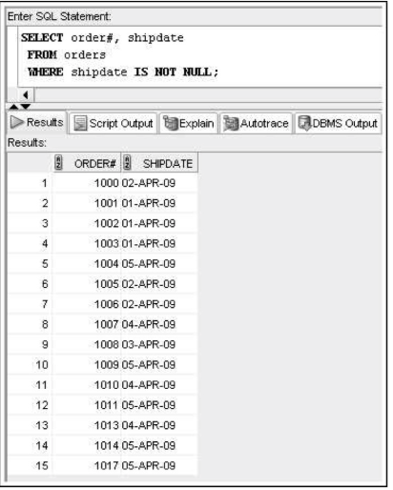
Treatment of NULL Values
Can also use IS NOT NULL
©2016. Cengage Learning. All rights reserved.

Slide 36
ORDER BY Clause Syntax
The ORDER BY clause presents data in sorted order
Ascending order is default
Use DESC keyword to override column default
255 columns maximum
©2016. Cengage Learning. All rights reserved.

Slide 37
ORDER BY Clause Syntax
Sort Sequence
In ascending order, values will be listed in the following sequence:
      Numeric values
      Character values
      NULL values
In descending order, sequence is reversed
©2016. Cengage Learning. All rights reserved.

Slide 38
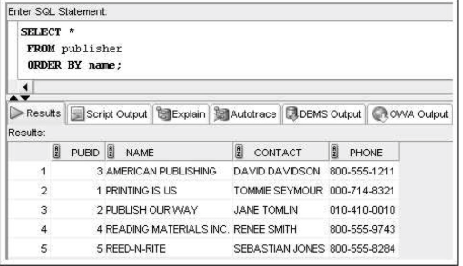
ORDER BY Example
©2016. Cengage Learning. All rights reserved.

Slide 39
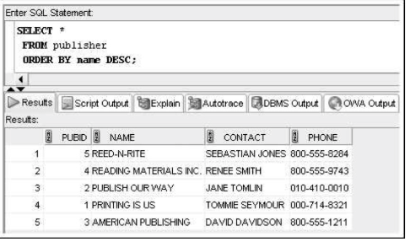
ORDER BY Example
©2016. Cengage Learning. All rights reserved.

Slide 40
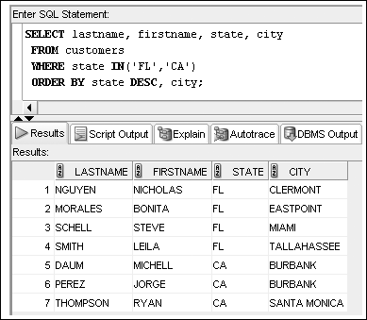
ORDER BY Example
©2016. Cengage Learning. All rights reserved.

Slide 41
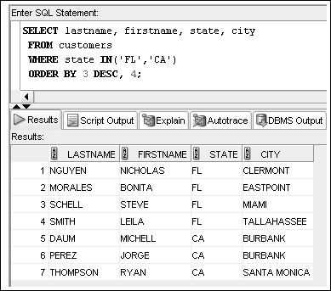
ORDER BY Can Reference
Column Position
©2016. Cengage Learning. All rights reserved.

Slide 42
Summary
The WHERE clause can be included in a SELECT statement to restrict the rows returned by a query to only those meeting a specified condition
When searching a nonnumeric field, the search values must be enclosed in single quotation marks
Comparison operators are used to indicate how the record should relate to the search value
The BETWEEN...AND comparison operator is used to search for records that fall within a certain range of values
©2016. Cengage Learning. All rights reserved.

Slide 43
Summary (continued)
The LIKE comparison operator is used with the percent and underscore symbols (% and _) to establish search patterns
Logical operators such as AND and OR can be used to combine several search conditions
When using the AND operator, all conditions must be TRUE for a record to be returned in the results
  However, with the OR operator, only one condition must be TRUE
A NULL value is the absence of data, not a field with a blank space entered
©2016. Cengage Learning. All rights reserved.

Slide 44
Summary (continued)
Use the IS NULL comparison operator to match NULL values; the IS NOT NULL comparison operator finds records that do not contain NULL values in the indicated column
You can sort the results of queries by using an ORDER BY clause; when used, the ORDER BY clause should be listed last in the SELECT statement
By default, records are sorted in ascending order; entering DESC directly after the column name sorts the records in descending order
A column does not have to be listed in the SELECT clause to serve as a basis for sorting
©2016. Cengage Learning. All rights reserved.

